Slide 1
Software Engineering
Lecture #16
Fakhar Lodhi

Slide 2
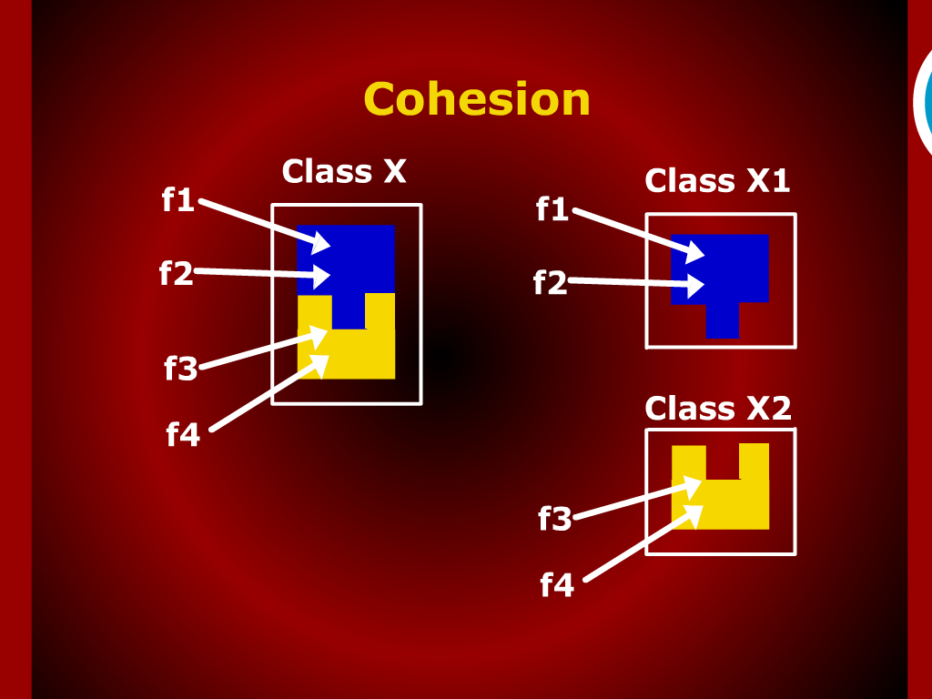
Cohesion

Slide 3
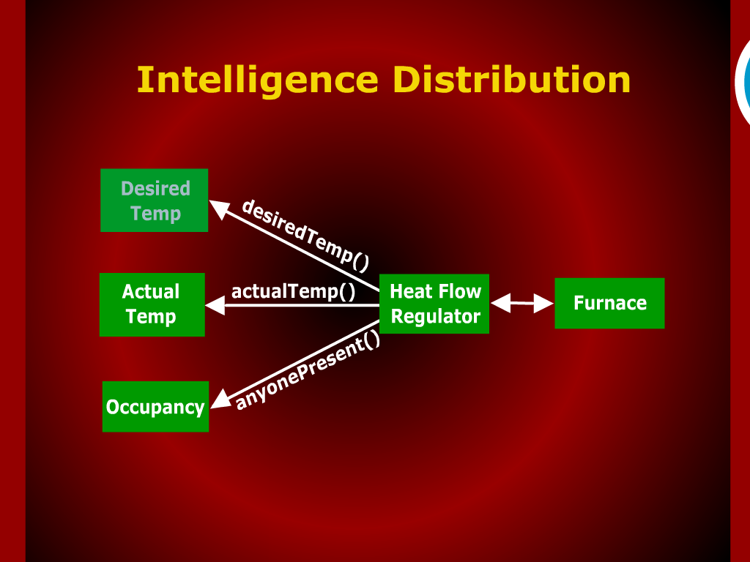
Intelligence Distribution

Slide 4
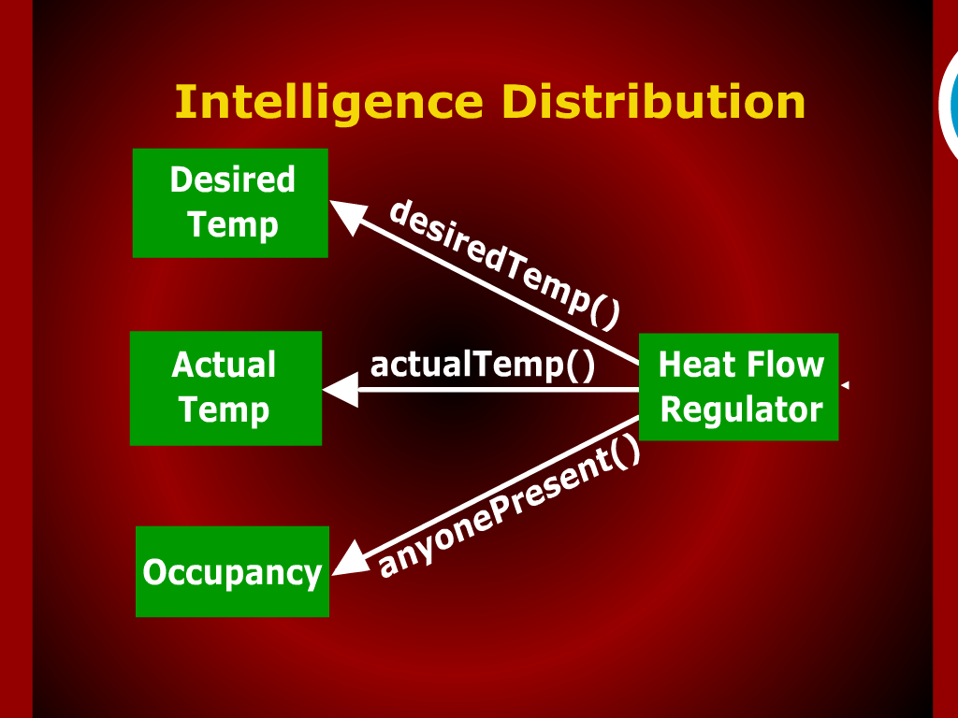

Slide 5
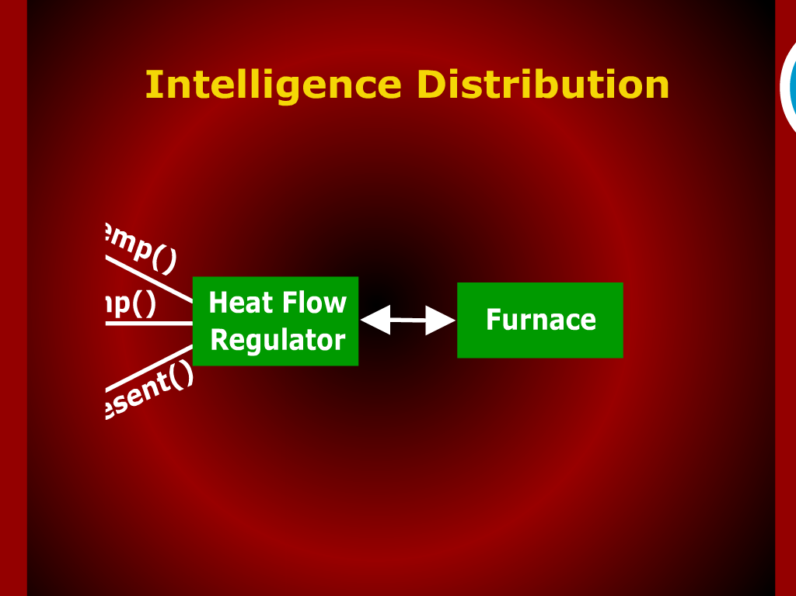

Slide 6
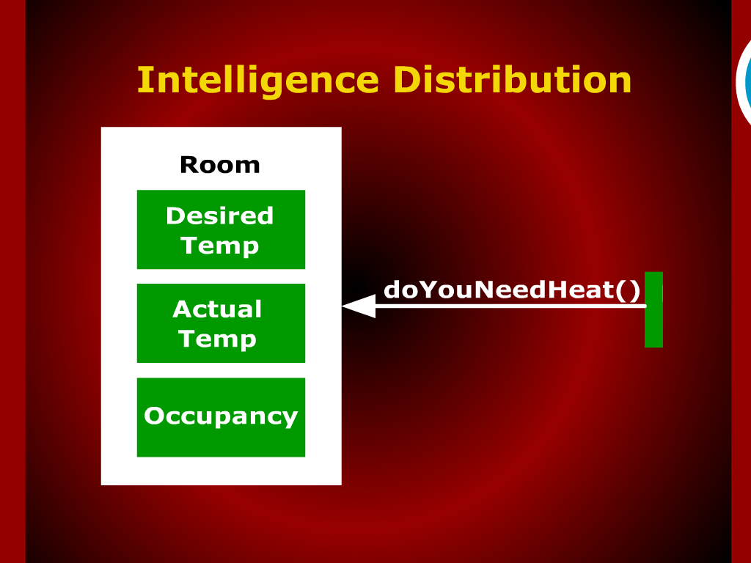
Intelligence Distribution

Slide 7
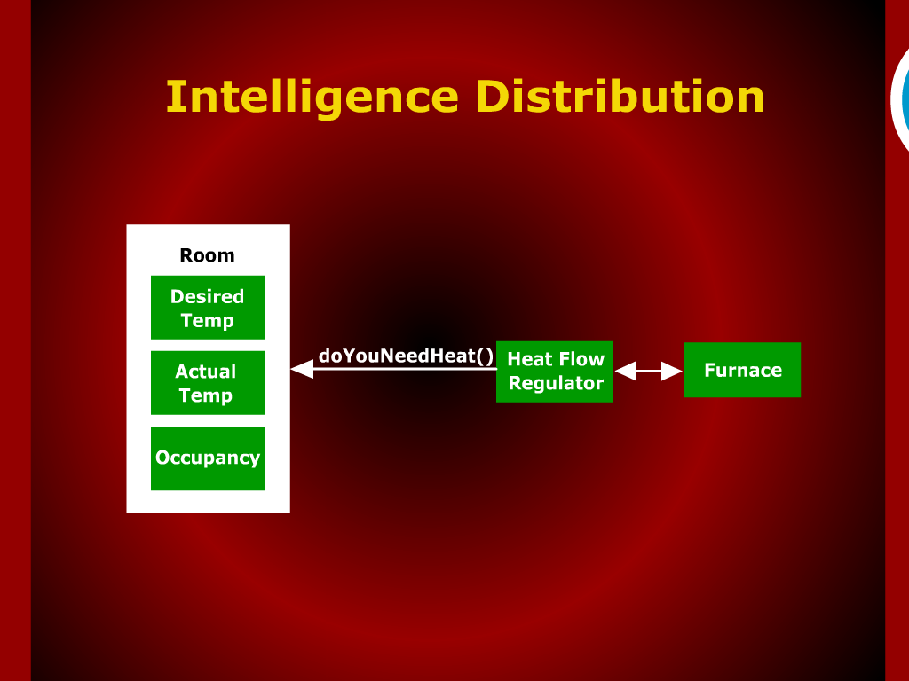
Intelligence Distribution

Slide 8
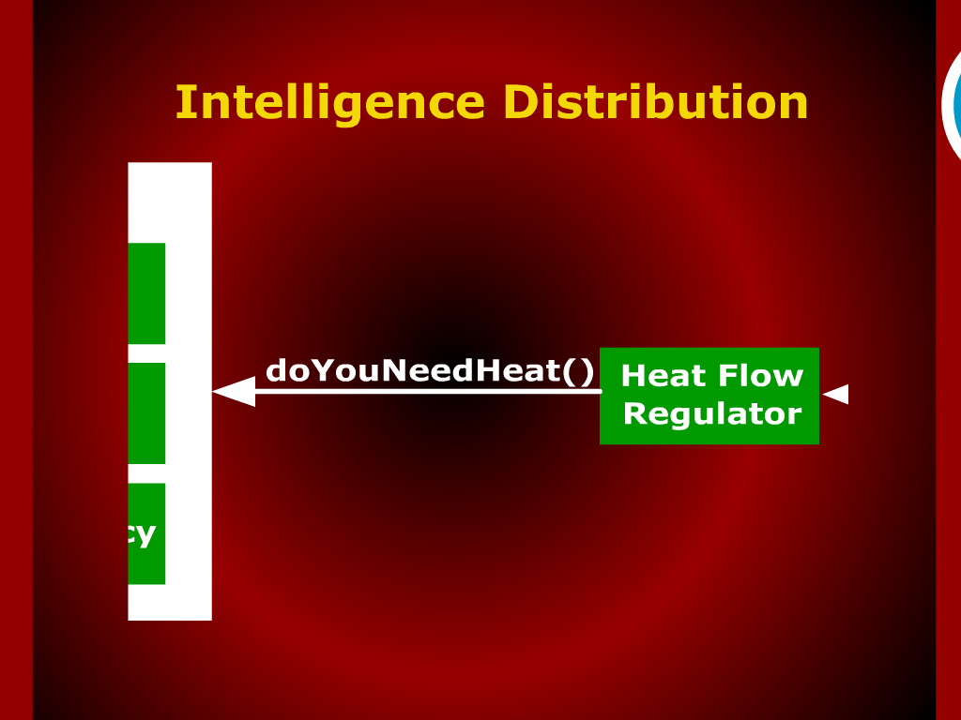
Intelligence Distribution

Slide 9
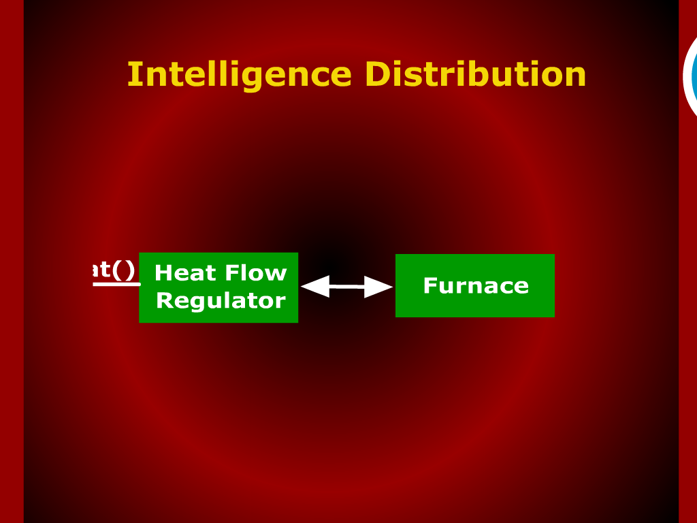
Intelligence Distribution

Slide 10
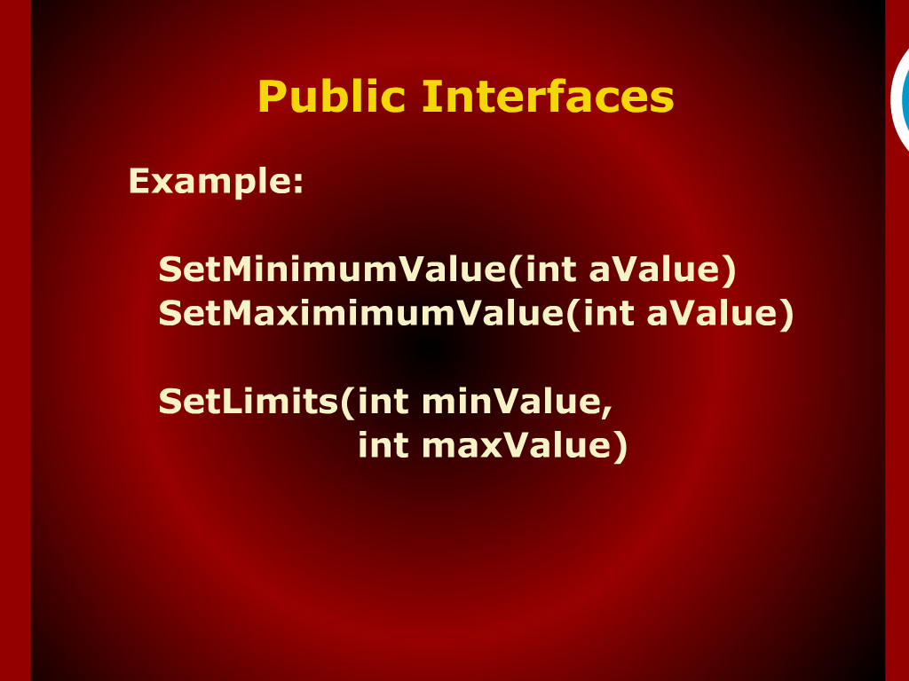
Public Interfaces

Slide 11
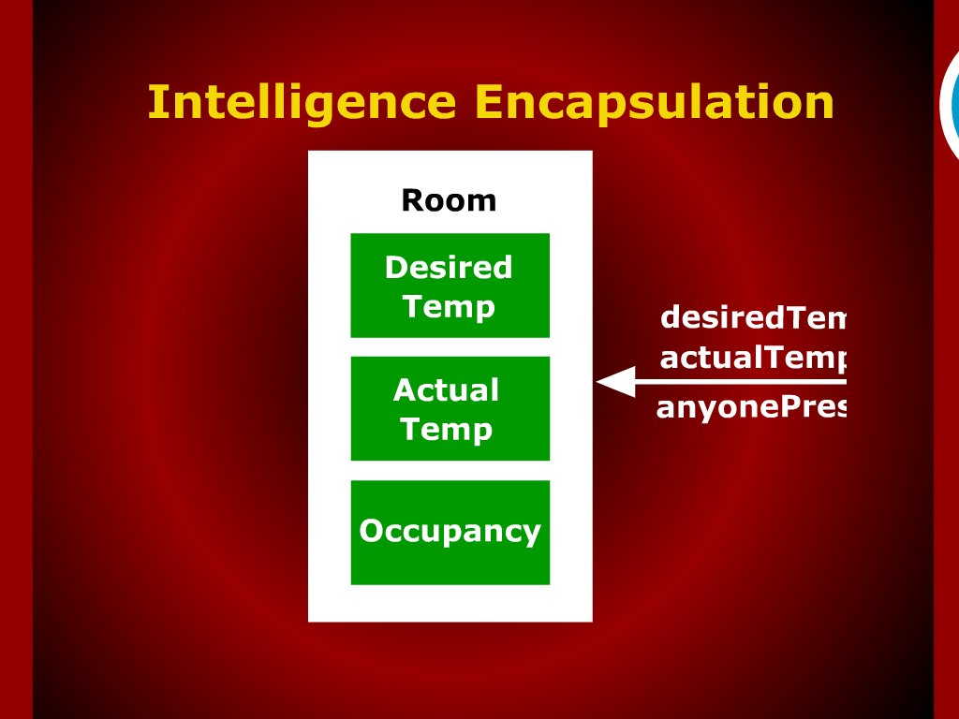
Intelligence Encapsulatin

Slide 12
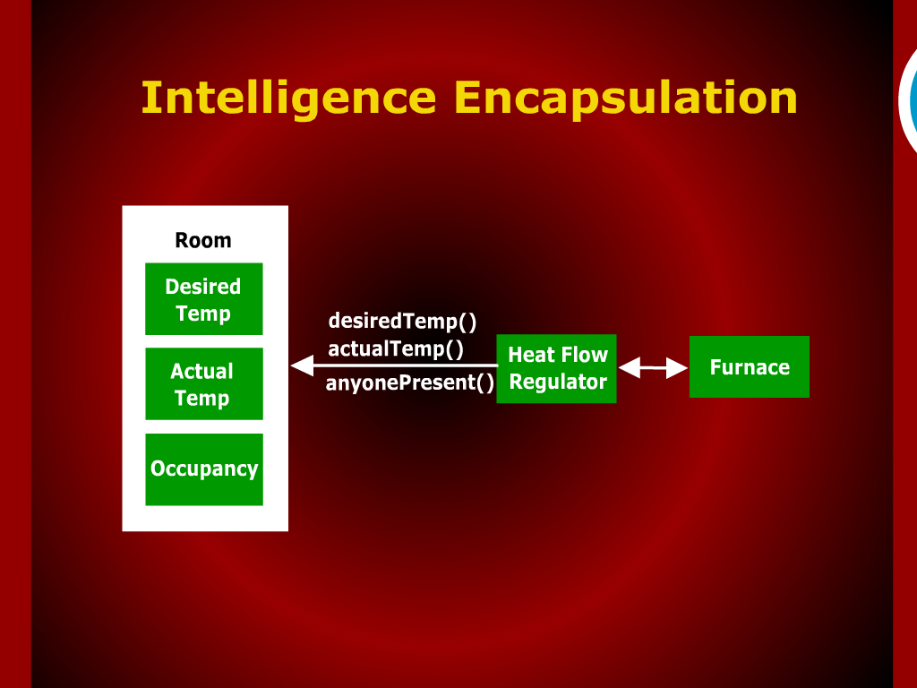
Intelligence Encapsulatin

Slide 13
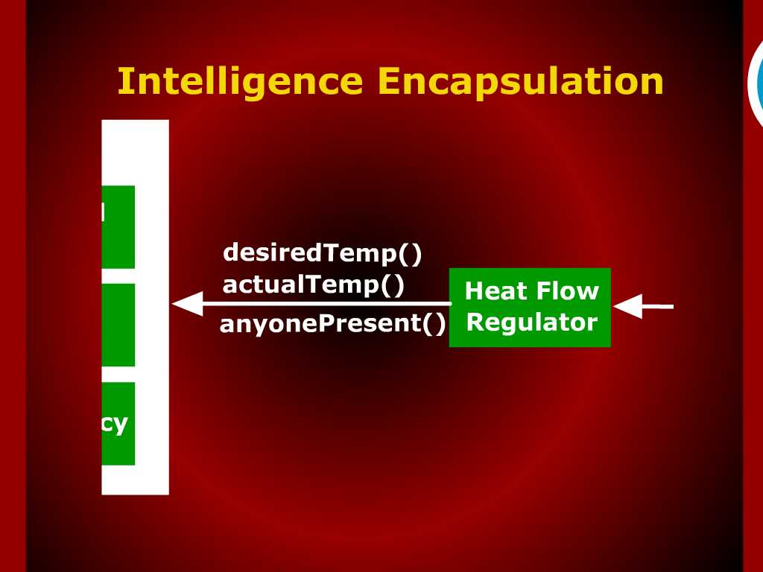
Intelligence Encapsulatin

Slide 14

Intelligence Encapsulation

Slide 15
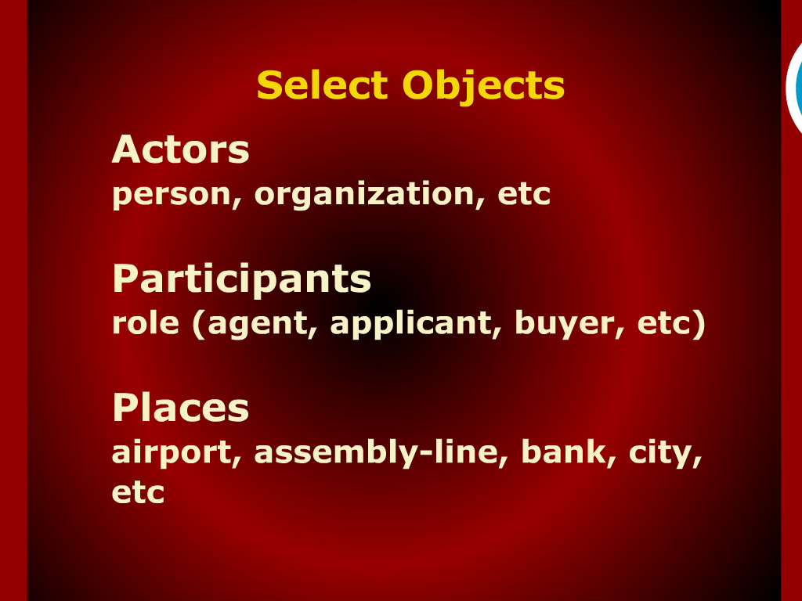
Select Objects

Slide 16
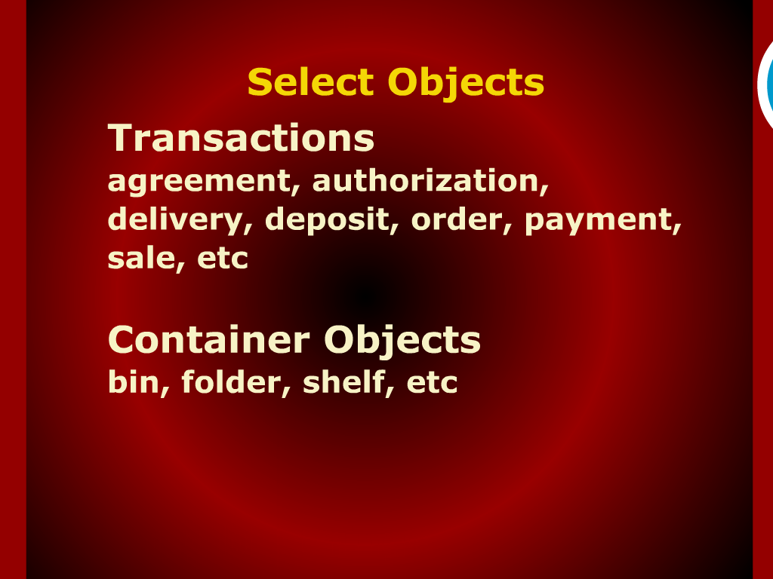
Select Objects

Slide 17
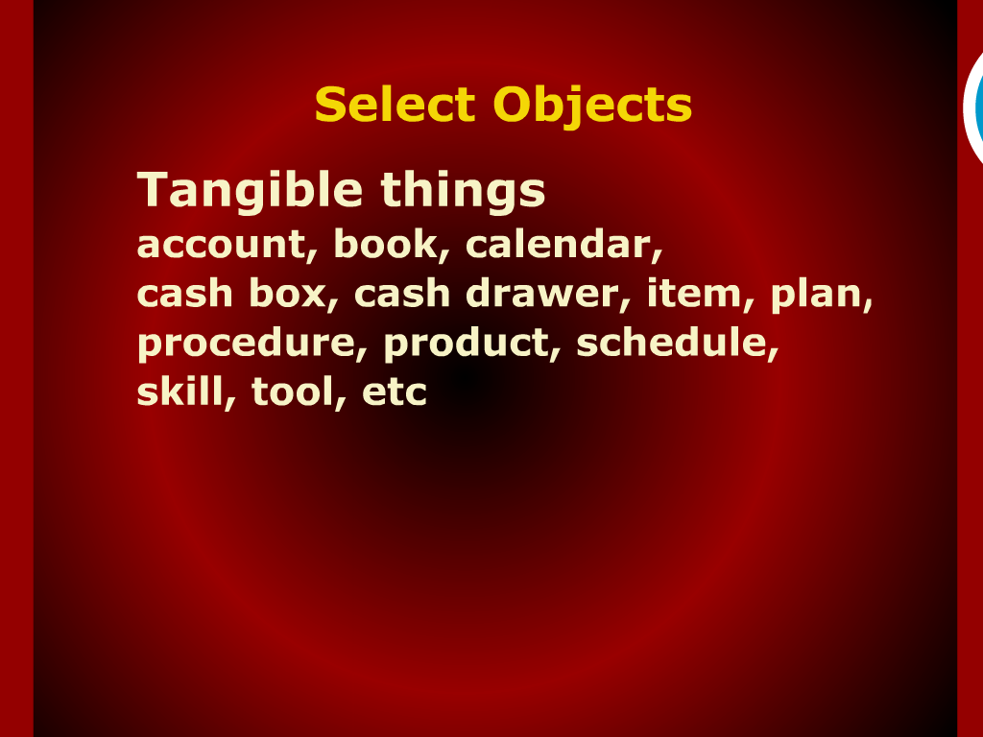
Select Objects

Slide 18
Recap

Slide 19
Cohesion

Slide 20
Managers Objects and Intelligence Distribution

Slide 21
Intelligence Encapsulation

Slide 22


Slide 23
Object Modeling using Coad’s Methodology

Slide 24
Select Objects

Slide 25
Identifying Structures

